Slide 1
Wie Softwareunternehmen von AI profitieren
REQ Global Compounders
Notes:
How to create returns: Compounding formula
How to mitigate risk: Tree analogy
Berkshre, men hva om det finnes tilsvarende selskaper som er bare en brøkdel av størrelsen
Oppkjøpsdrevne konglomerater

Slide 2
Disclaimer
This presentation (the "Presentation") has been prepared by REQ Capital AS (the "Manager") and provides information about the strategies for the Irish UCITS funds REQ Global Compounders and REQ Nordic Compounders (collectively the "Funds"). The Manager, in the capacity as an investment firm, conduct portfolio management of the Funds on a delegated basis with Waystone Management Company (IE) Limited being the UCITS management company of the Funds. For more information and access to relevant fund documents, please see the website of the Manager.
This information is intended for general information purposes only and does not constitute solicitation of or an offer to participate in any investment. This information does not, nor does it purport to, constitute any form of investment advice, recommendation, or independent analysis. Consequently, it has not been prepared in accordance with the rules and regulations governing such publications, including but not limited to any prospectus requirements. This information is not, and does not purport to be, complete. The information is strictly confidential and should not be copied or circulated to anyone but the addressed recipients. The complete offering documents for the Funds should be read carefully and potential investors should seek independent investment advice and tax and other legal advice before potentially making an investment. No assurance can be given that the stated investment objectives will be achieved, and the value of investments may fall as well as rise. Past performance is no guarantee for future returns.
An investment in the Funds are solely for investors who are qualified to invest in the Funds in accordance with applicable laws in the relevant investor's home jurisdiction. The Funds are unsuitable and unavailable for any person or entity not meeting such qualifications. An investment in the Funds are only intended for investors who understand the investment strategies of the Funds, who can accept the risks associated with such an investment and who have no need for immediate liquidity in their investment. Investments may be subject to strict limitations on redemption and transferability. There will be no secondary or public market. The foregoing list of risk factors is not complete. If you are unsure as to whether or not you qualify, please contact the Manager or a professional advisor.
The Manager makes no warranties that the material in this presentation is appropriate or available for use in countries other than Norway. Persons receiving this information are obliged to investigate whether there are any restrictions in their jurisdiction, and if so, to comply with any such restriction. The Manager does not accept any responsibility for any failure to comply with any such restriction. For further information, please contact the Manager or a professional advisor.
This Presentation may include certain opinions, forward-looking statements, forecasts, and/or beliefs. These opinions, forward-looking statements, forecasts, and/or beliefs reflect the Manager's subjective beliefs and opinions, and no representation is made that any of these opinions, forward-looking statement.
The Funds are subject to Regulation (EU) 2019/2088 of the European Parliament and of the Council of 27 November 2019 on sustainability‐related disclosures in the financial services sector (“SFDR”). It is the understanding of Waystone Management Company (IE) Limited and the Manager that the reporting requirements set forth in accordance with SFDR Article 8 shall apply with respect to the Funds. Subsequently, reporting will be made in accordance with these rules. Please note that changes in the SFDR regime and associated regulations may result in a different classification for reporting under SFDR.
The Manager, its directors, employees, and consultants do not accept any form of liability (whether arising in contract, tort, negligence or otherwise) for any error, omission, or similar misrepresentation in this general information or for any loss or damage (whether direct, indirect, consequential or otherwise) suffered by the recipient of this information or any other person

Slide 3
History lesson

Slide 4
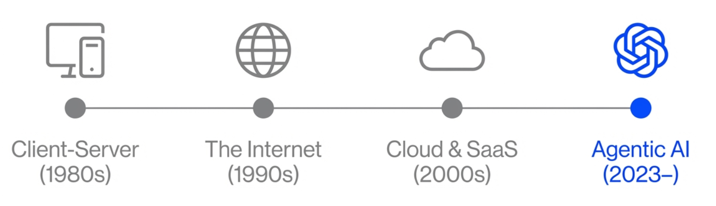
We have seen four major waves over the last 45 years
Every technical innovation has been an opportunity

Slide 5
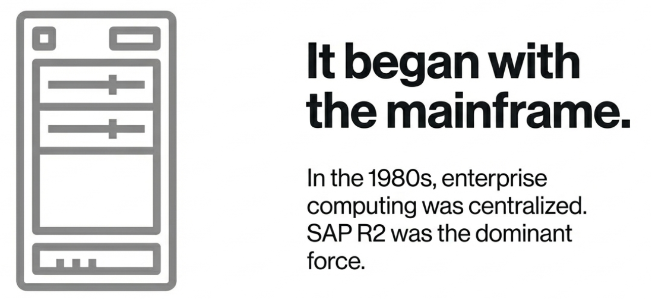

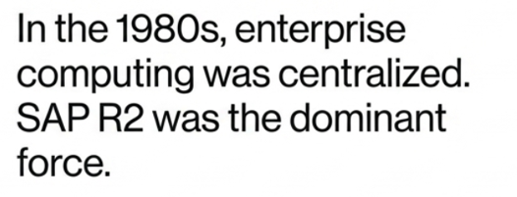
It All Began with the Mainframe…

Slide 6
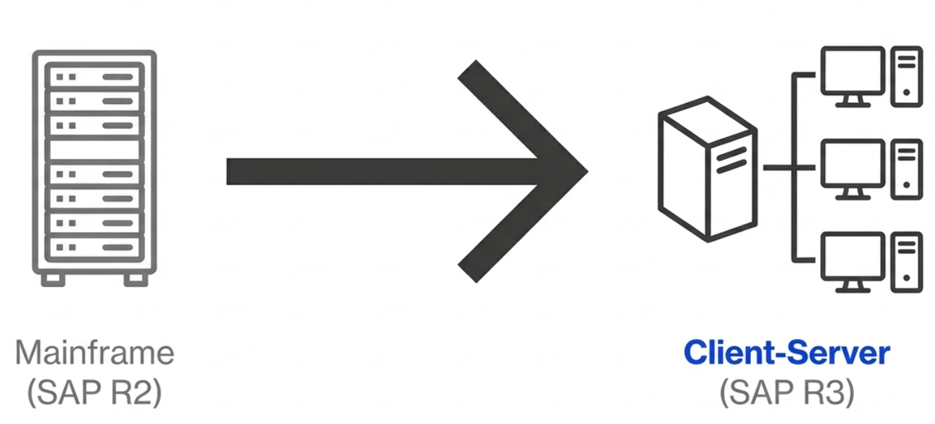
Then, a fundamental architectural shift created new value
SAP generated a lot of value moving its entire client base to the new architecture

Slide 7
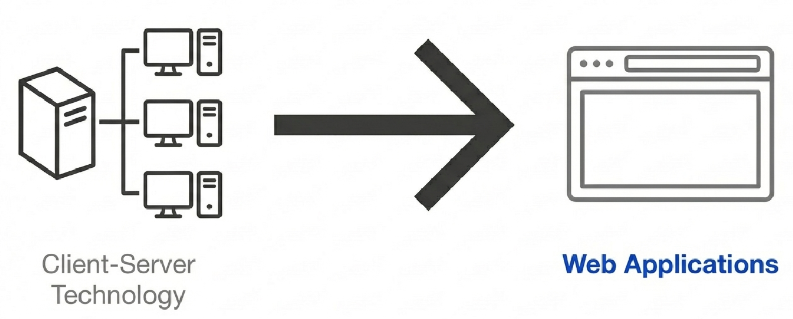
The next wave followed the same pattern

Slide 8
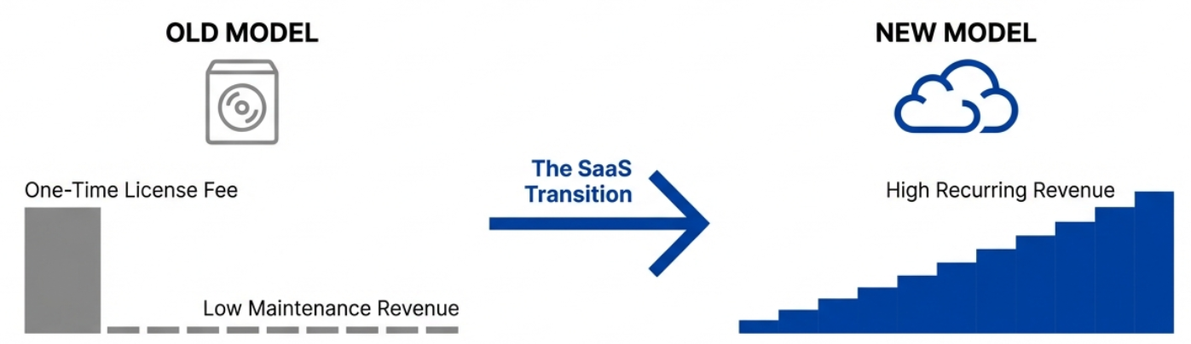
Shifting to Higher-Value Recurring Revenue Streams
CSI broadly benefited from the creation of new business models (web apps)

Slide 9
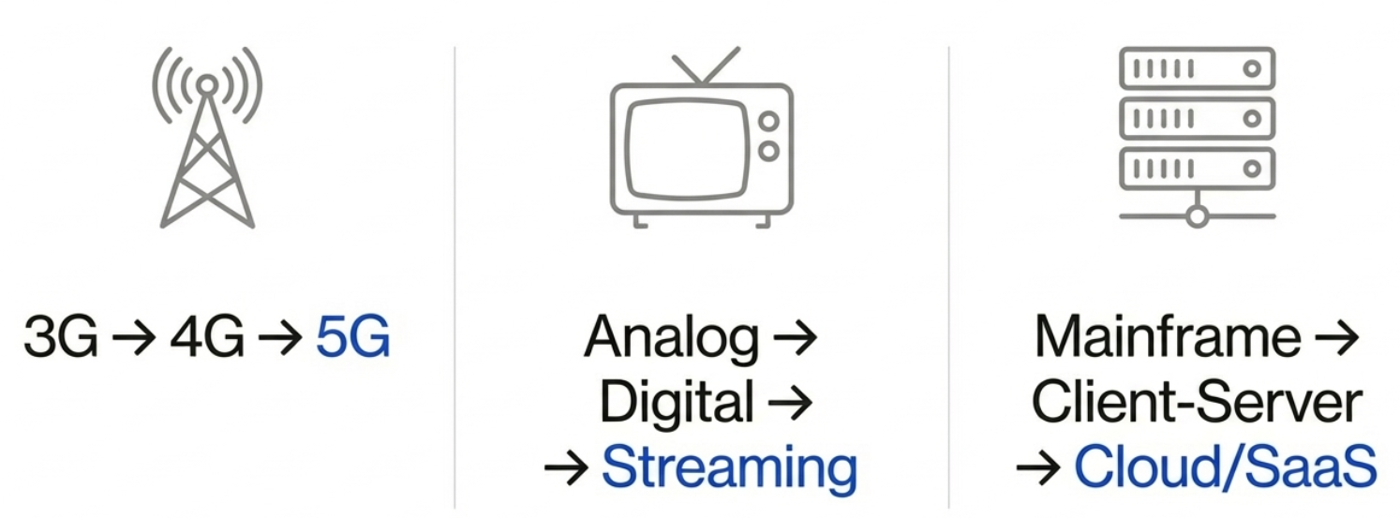
Shifts Across Industries
We have seen four major waves over the last 45 years

Slide 10
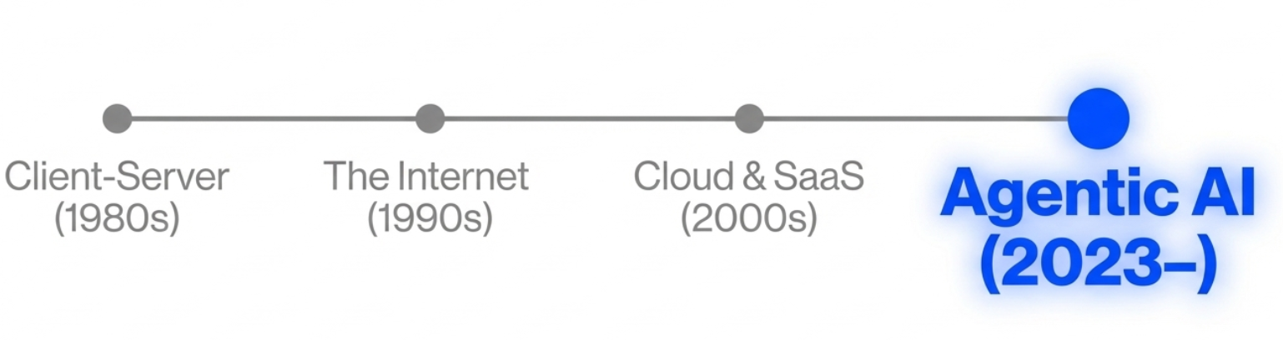
And now, the next architectural shift is here

Slide 11
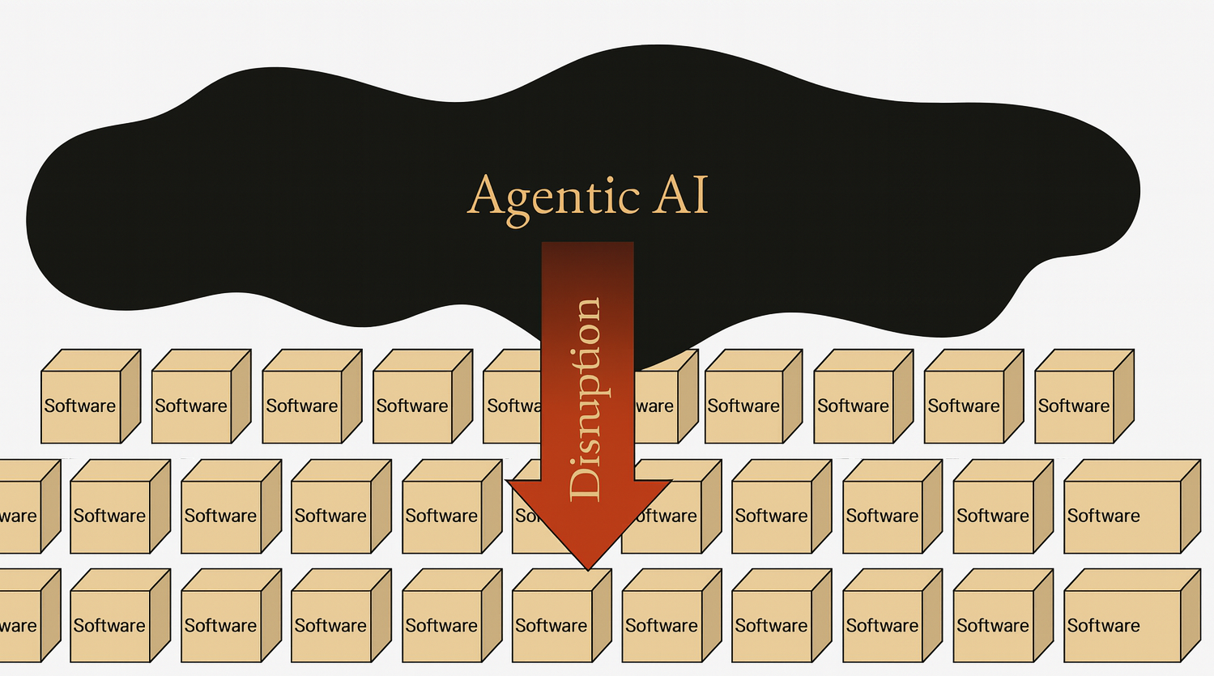
Narratives Drive Prices — And Prices Drive New Narratives
“The notion that business applications exist — that's probably where they'll all collapse in the agent era. Because if you think about it, they're essentially CRUD databases with a bunch of business logic. The business logic is all going to these agents.” - Satya Nadella (BG2 with Bill Gurley & Brad Gerstner, Dec 2024)
“Right now we're in an agentic AI moment where the industrial software complex of the 20th century is being integrated, and in some cases, drastically reduced in numbers of applications and moved to the ServiceNow platform,“ – Bill McDermott (CEO of ServiceNow, former CEO of SAP)
“I would go short vertical SaaS, vertical software companies, and long cloud providers that have AI tools and platforms that will allow enterprises to build custom applications in a low-cost, low-code way.” – David Friedberg, Allin podcast, Episode 160 (Predictions for 2024)
Notes:
What happened?

Slide 12
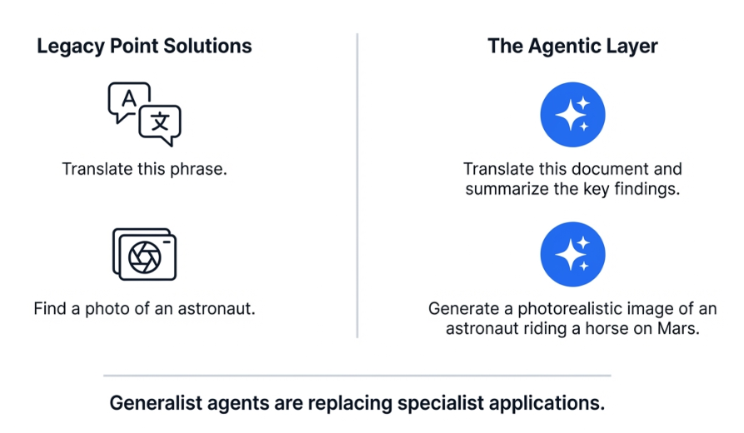
How SaaS (Point Solutions) Might Get Replaced
According to Nadella and other business leaders

Slide 13
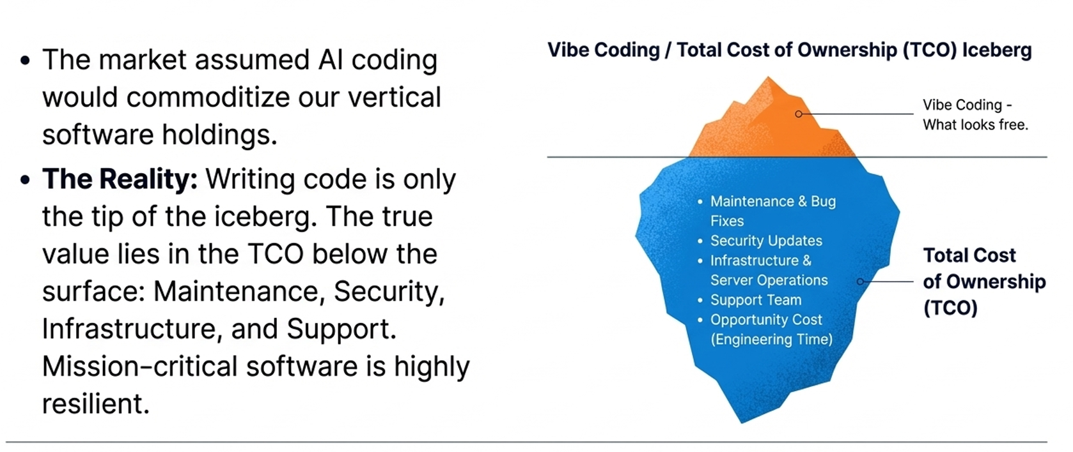
Vibe coding

Slide 14
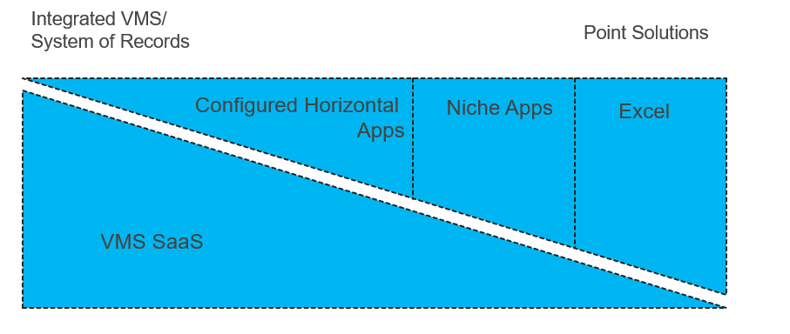
VMS Today: A Hodgepodge of Applications
Used with permission (K. Reimer)

Slide 15
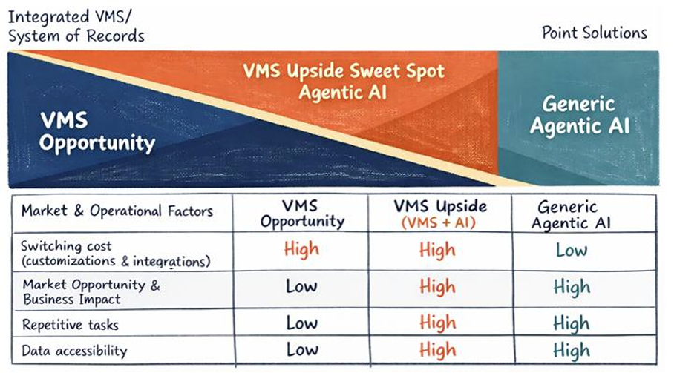
Likely Scenarios?
Used with permission (K. Reimer)

Slide 16
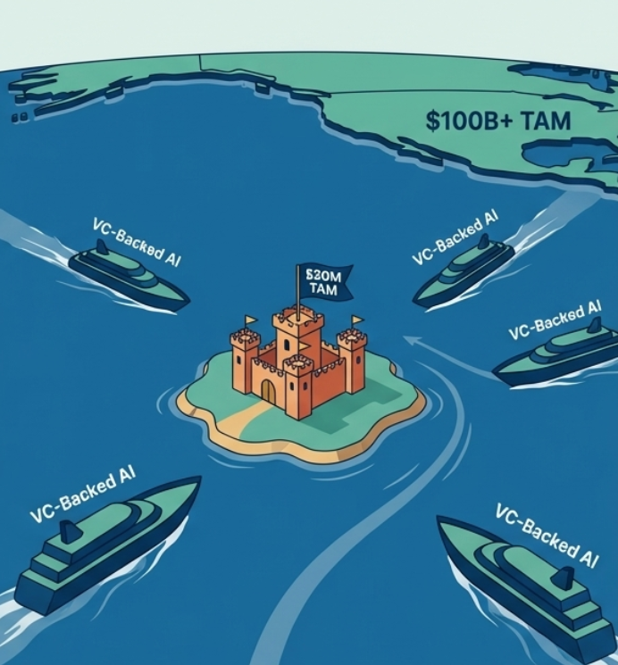
Disruptor Perspective: What Is the Price to Win?
AI lowers the cost of building software, but it doesn`t change the size of the market
VC Mismatch: Investors need huge markets to justify investments. They fund broad tools (e.g., CRM) rather than small niche markets only allowing a few players ($10M–$50M).
Small Prize Problem: Disrupting many tiny, profitable niches isn’t worth the effort for well-funded AI companies.
Micro-SaaS Reality: Solo developers can clone code with AI, but they can’t replicate enterprise sales relationships or handle complex legacy data migrations required in niche markets.
Notes:
First principles

Slide 17
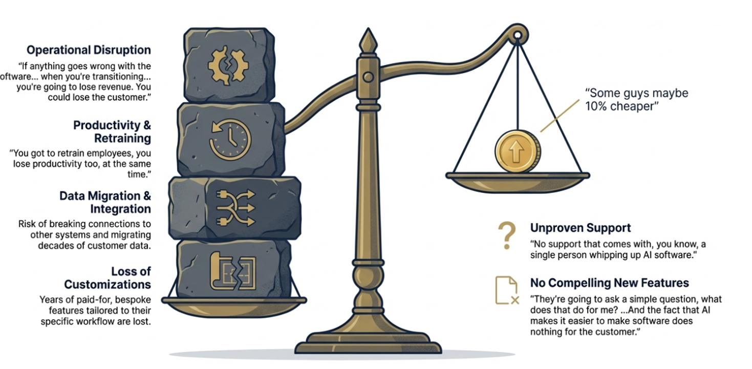

Client Perspective: Does Switching Make Sense?
The hassle of switching versus the savings

Slide 18
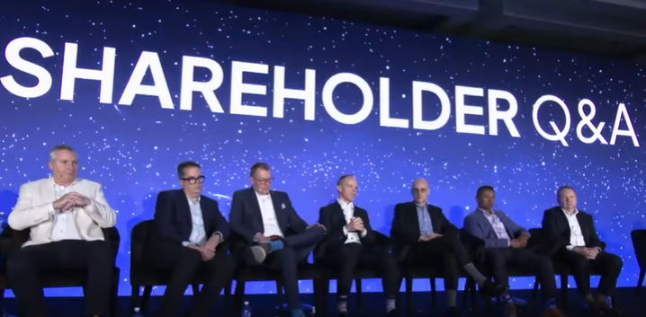
Constellation Software AGM 2026
AI is the main theme, but so far more as a productivity and innovation driver than as a proven new revenue source.
A decentralized model may be an advantage in the AI shift: 1,600+ small units can experiment closely with customers and scale what works.
AI is dramatically changing development speed: some cases went from development cycles measured in months to hours, and from “system of record” to “system of action”.
Customer distribution and trust remain most important: building the product isn’t enough; success requires customers to actually adopt it.
Incumbent advantages persist: long procurement processes, regulatory requirements and liability mean new AI-native competitors won’t necessarily win quickly.
Capital allocation remains the core focus: M&A is prioritized over buybacks, and PEMS is used as a new tool to invest in publicly listed software companies.
No clear AI-driven churn yet, but management appears aware of the risk and is monitoring developments closely.

Slide 19
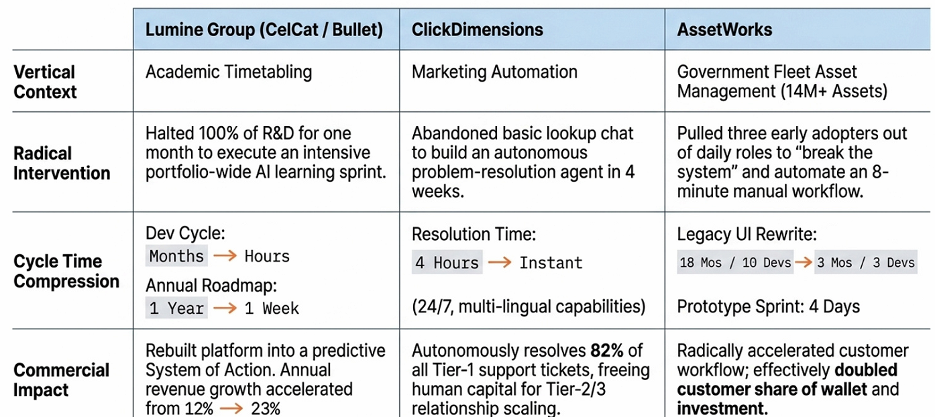
AI examples mentioned during CSI AGM 2026
Notes:
First principles

Slide 20
Lumine Group: Going Deep Into the Back Office of Enterprise Clients

Slide 21
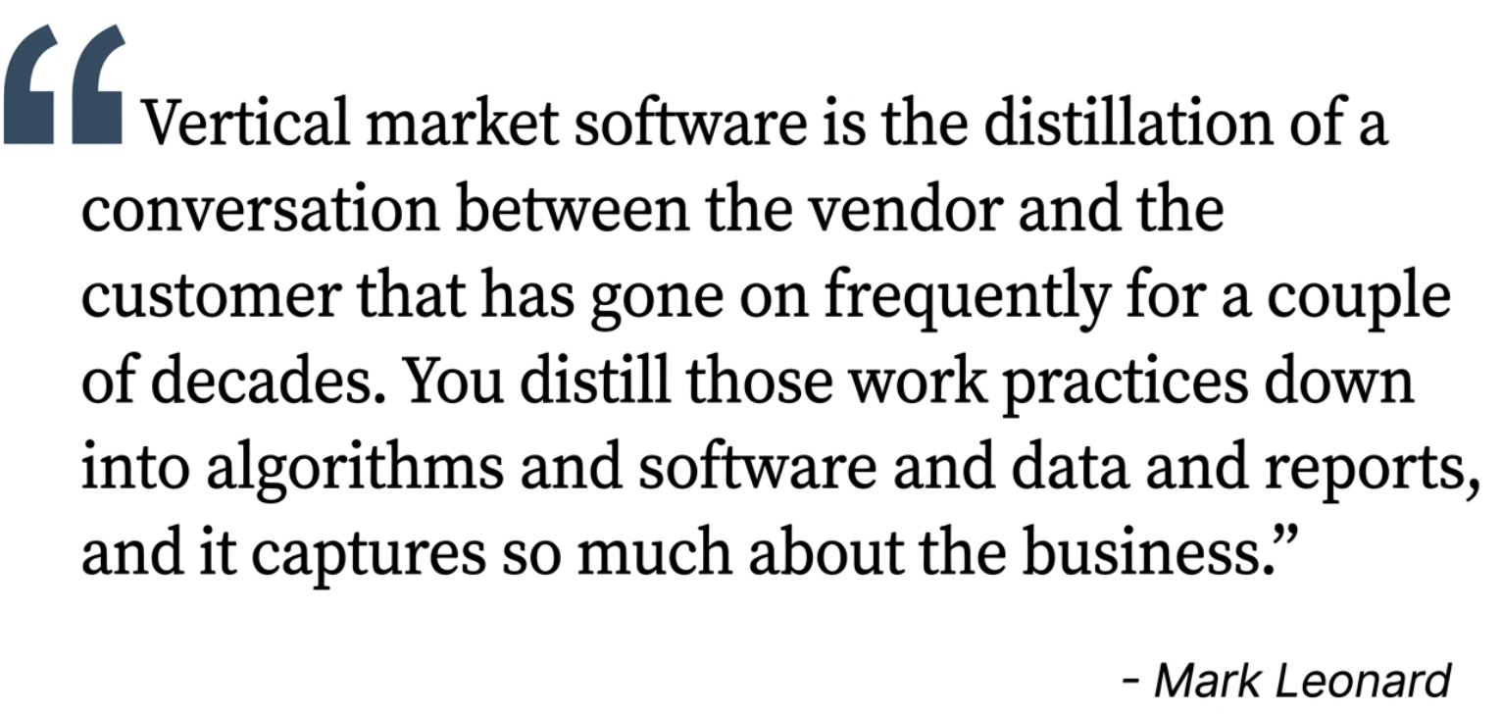
Lumine Group (Top 2 Position)

Slide 22
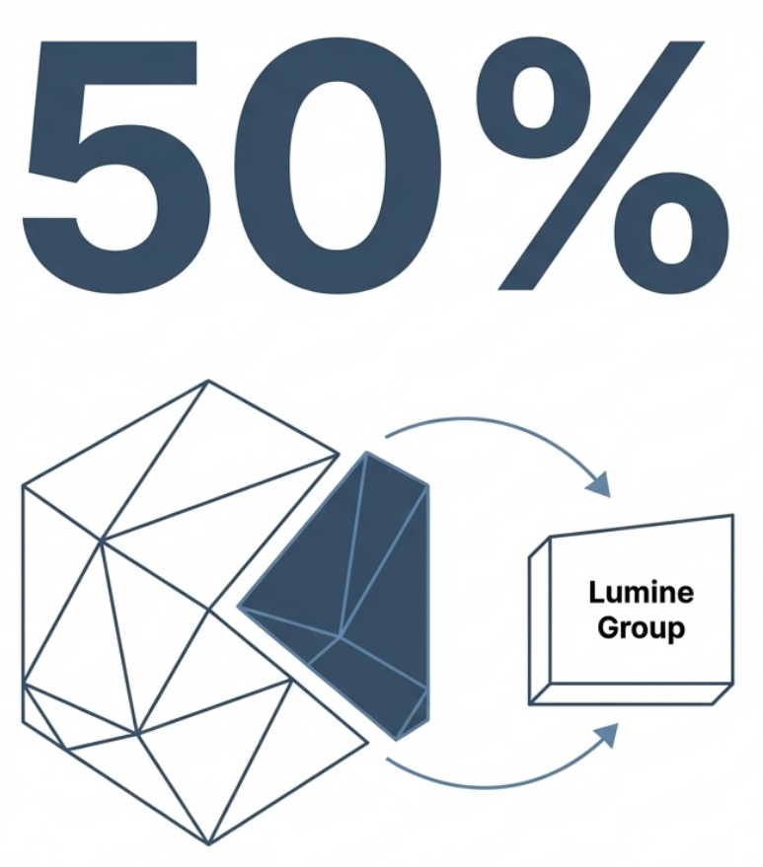
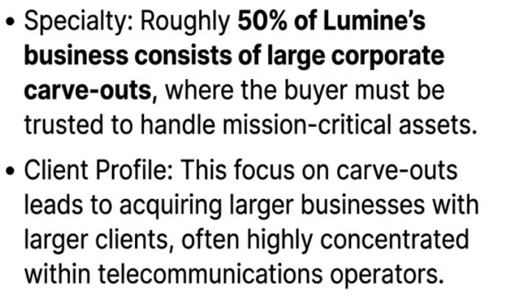
Lumine Group: Trusted buyer Serving Critical Infrastructure

Slide 23
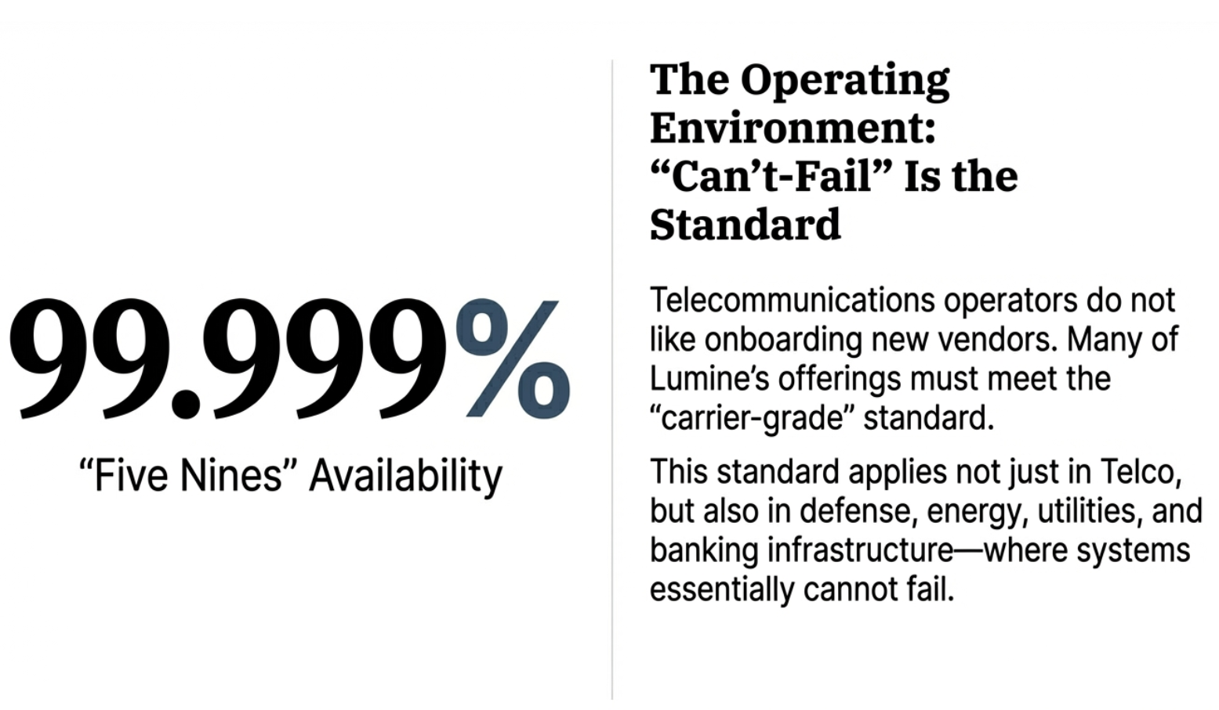

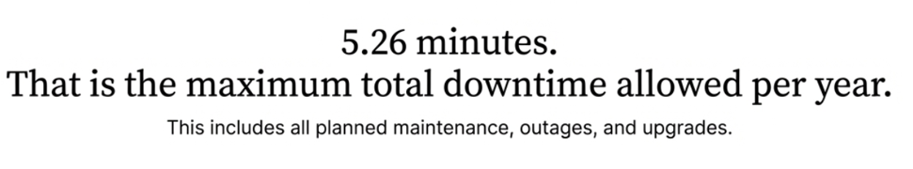
Reliability Requirements for Lumine Group

Slide 24
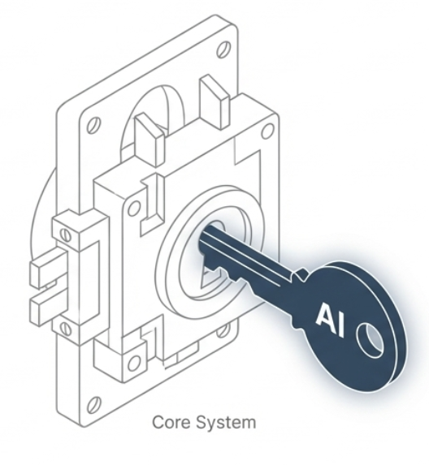
Security Requirements for Lumine Group
Vendors must meet and maintain industry-specific regulatory standards.
Continuous compliance audits are expected, with evidence of robust security frameworks (e.g. ISO/IEC 27001, SOC 2, or sector-specific frameworks).
Data handling, encryption, access control, and incident response capabilities must be well-documented and consistently tested.
Avoid onboarding new vendors unless absolutely necessary.
Enforce long evaluation and approval cycles, often spanning 24 months.
Once approved, a vendor is often deeply embedded and remains for the long term—unless they fail operationally, ethically, or strategically.

Slide 25
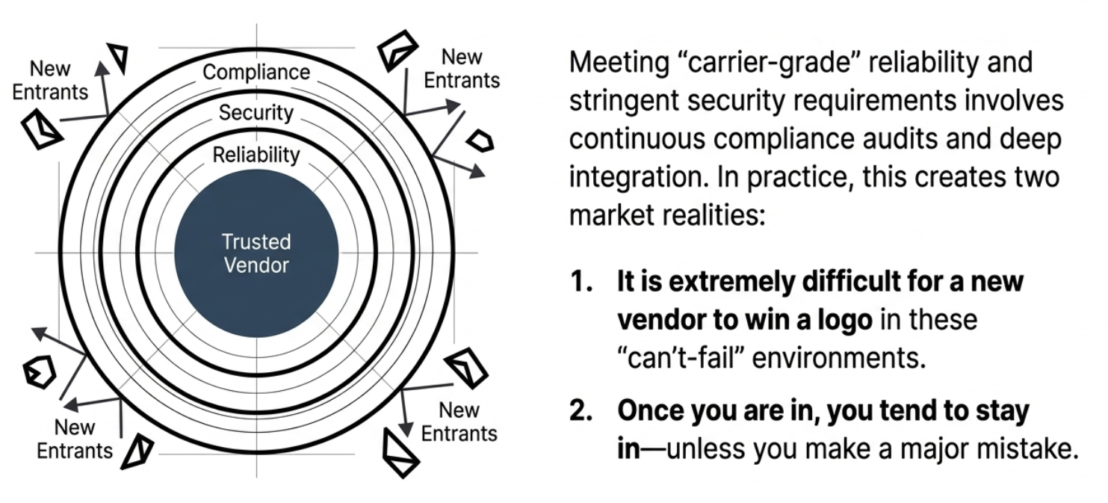
The Result is a Powerful Moat

Slide 26
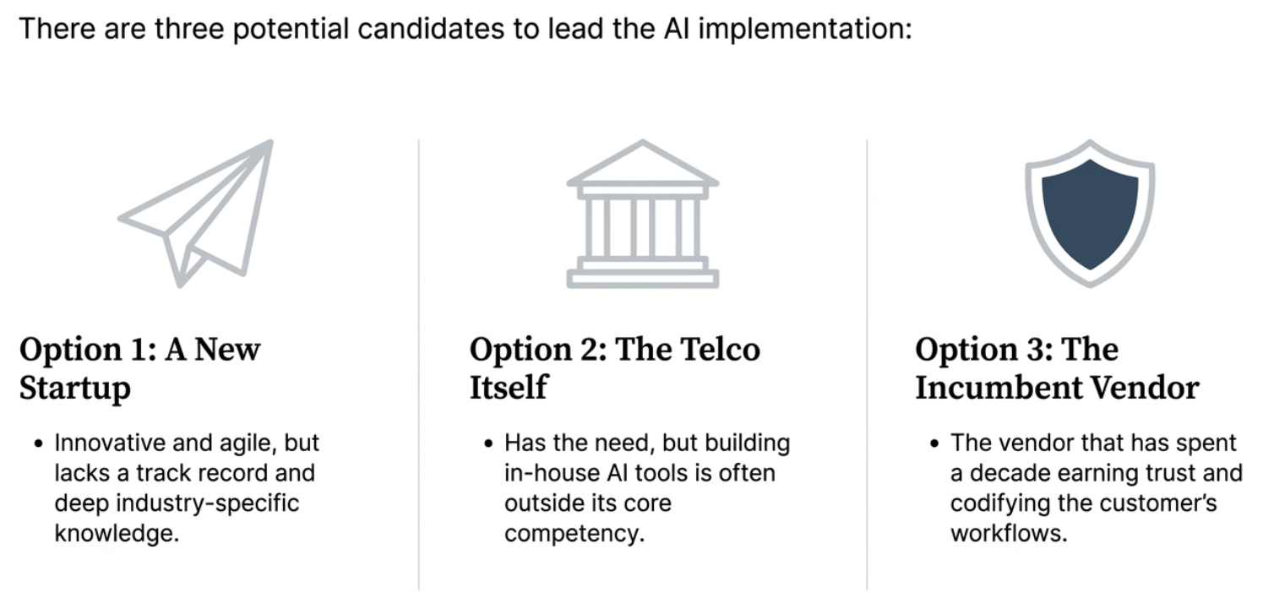
Who Is Trusted to Implement and Upsell AI-related Tools?

Slide 27



